Slide 1
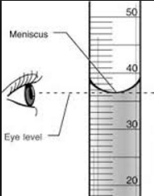
Making Measurements
Volume of a graduated cylinder:
Always read from the bottom of the meniscus!
Timing Devices:
Clock, stopwatch, light-gate timer

Slide 2
Common Errors
Line-of-sight error
Reaction time
Misalignment of the light beams on the light gate

Slide 3
Period of a Pendulum
Period: time it takes for the pendulum to swing back and forth once from its resting position
To measure:
Place a marker under the rest position
Ensure line-of-sight
Time how long it takes to make 10 oscillations
Repeat 2 more times
Calculate period= $\frac{Average time }{\# of oscillations}$

Slide 4
Measurement Lab:
There are 6 stations to rotate through
7 minutes per station---we will not finish in one day!
Stay on task
Be respectful of surrounding classes (keep the volume down)
Use common sense

